Slide 1
Introduction to Azure SQL Database
Notes:
This is intended for SQL Server people. But if you’re not a SQL Server person, still a good way to get a general understanding of security for Azure SQL.

Slide 2
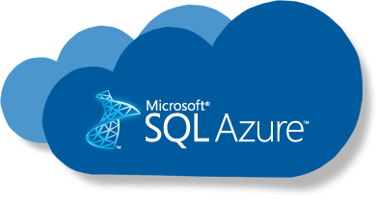
Upcoming Agenda
September 14th - Azure SQL Family Overview
September 21st - Azure SQL Database Configuration
September 28th - Azure SQL Database Performance Tuning
Today’s Agenda
Configure Azure SQL Database
Provisioned vs Serverless
SQL Database Elastic Pools

Slide 3

Azure SQL Family Azure SQL Database
Notes:
https://github.com/microsoft/sqlworkshops-azuresqlworkshop/blob/master/azuresqlworkshop/05-Availability/basic-ha/basic-ha.ipynb
Need to have a BC and GP database deployed in order to do side by side

Slide 4
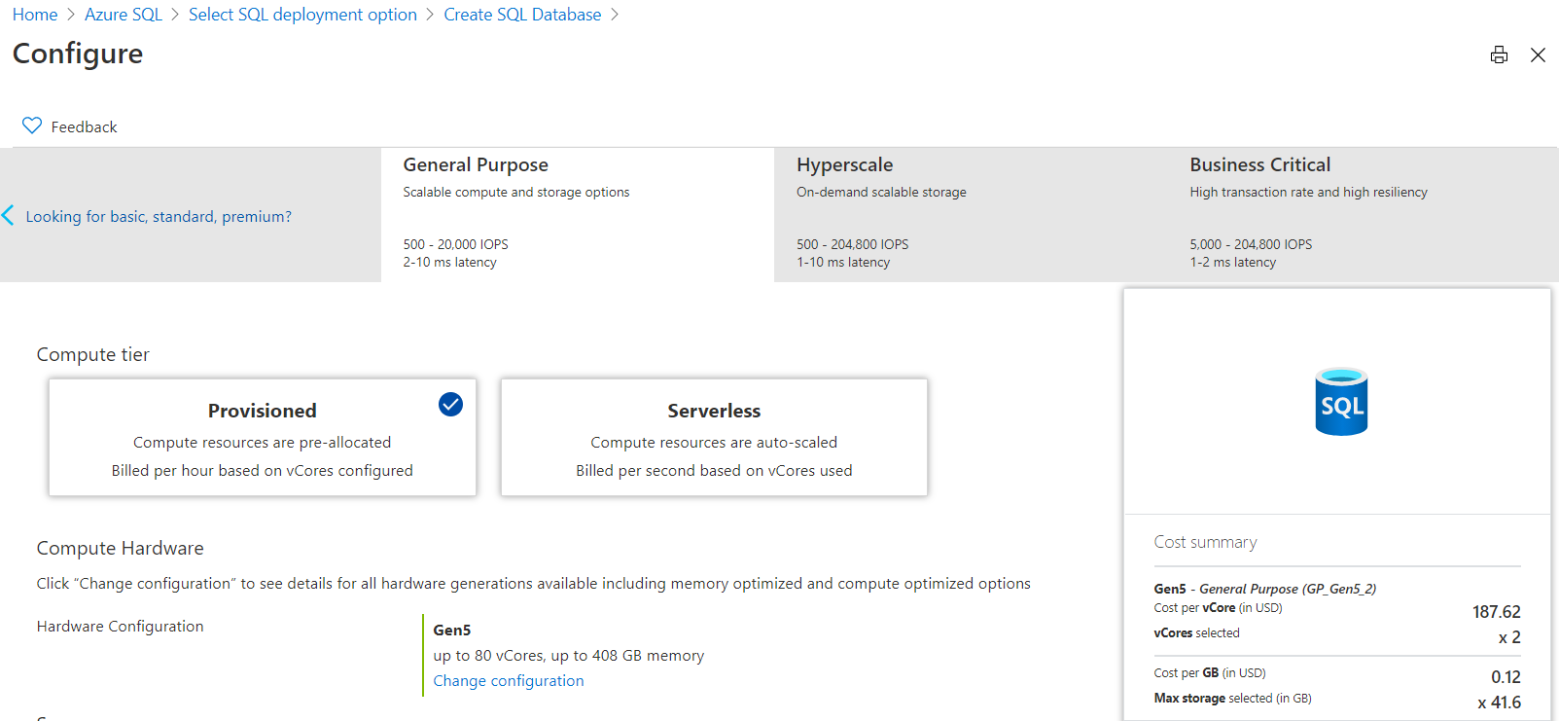
Configuration Options- Azure SQL Database
Notes:
Vcore choices (up to 80 vCore is the same)
Azure SQL Database
Pick Purchasing Model
If DTU, choose Basic, Standard, or Premium
If vCore then pick Service Tier
If Service Tier is GP, then pick Compute Tier (Provisioned or Serverless) and Compute Hardware
If Hyperscale, pick Compute Hardware and number of Replicas
If BC, pick Compute Hardware, Read Scale out Enabled?, and Zone Redundant?
Azure MI
Choose Service Tier and Compute Hardware
Overview: Azure SQL Database enables you to easily purchase fully managed PaaS database engine that fits your performance and cost needs. Depending on the deployment model of Azure SQL Database, you can select the purchasing model that fits your needs:
Talking Points:
Azure SQL Database give you flexible purchasing models to have simple preconfigured compute & storage or independent control over compute & storage.
vCore model. This model allows you to independently choose compute and storage resources. It also allows you to use Azure Hybrid Benefit for SQL Server to gain cost savings.
Best for customers who value flexibility; control and transparency
Customers can select compute and storage independently
Allows customers to right-size their compute requirements in the cloud
vCore sizing offers flexibility of choice
Database Transaction Unit (DTU) model. Bundled measure of compute, storage and IO resources.
Best for customers who want simple, pre-configured resource options
Reference
https://docs.microsoft.com/en-us/azure/sql-database/sql-database-service-tiers

Slide 5
Purchasing models - Azure SQL Database
DTU model
Simple, preconfigured
vCore model
Independent scalability
Compute
Compute
Microsoft’s recommendation
Storage
Storage
Pre-packaged, bundled unit that represents the database power.
Designed for predictable performance, but somewhat inflexible and limited in options.
DTU sizing offers simplicity of choice.
Blended measure of CPU, memory, and read-write rates.
This model allows you to independently choose compute and storage resources. It also allows you to use Azure Hybrid Benefit for SQL Server to gain cost savings.
Best for customers who value flexibility, control and transparency
Notes:
Vcore choices (up to 80 vCore is the same)
Azure SQL Database
Pick Purchasing Model
If DTU, choose Basic, Standard, or Premium
If vCore then pick Service Tier
If Service Tier is GP, then pick Compute Tier (Provisioned or Serverless) and Compute Hardware
If Hyperscale, pick Compute Hardware and number of Replicas
If BC, pick Compute Hardware, Read Scale out Enabled?, and Zone Redundant?
Azure MI
Choose Service Tier and Compute Hardware
Overview: Azure SQL Database enables you to easily purchase fully managed PaaS database engine that fits your performance and cost needs. Depending on the deployment model of Azure SQL Database, you can select the purchasing model that fits your needs:
Talking Points:
Azure SQL Database give you flexible purchasing models to have simple preconfigured compute & storage or independent control over compute & storage.
vCore model. This model allows you to independently choose compute and storage resources. It also allows you to use Azure Hybrid Benefit for SQL Server to gain cost savings.
Best for customers who value flexibility; control and transparency
Customers can select compute and storage independently
Allows customers to right-size their compute requirements in the cloud
vCore sizing offers flexibility of choice
Database Transaction Unit (DTU) model. Bundled measure of compute, storage and IO resources.
Best for customers who want simple, pre-configured resource options
Reference
https://docs.microsoft.com/en-us/azure/sql-database/sql-database-service-tiers

Slide 6
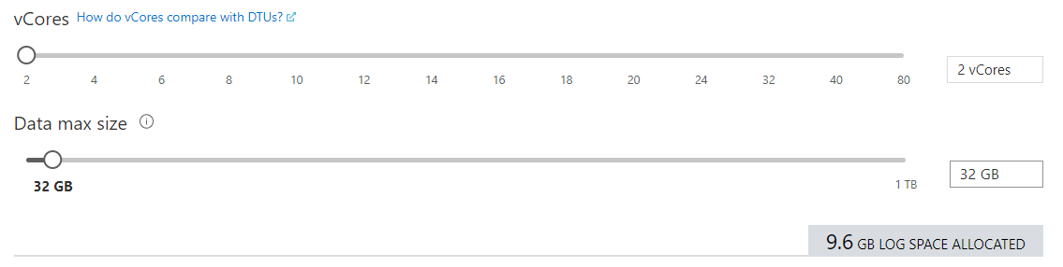
vCore Configuration
Notes:
Vcore choices (up to 80 vCore is the same)
Azure SQL Database
Pick Purchasing Model
If DTU, choose Basic, Standard, or Premium
If vCore then pick Service Tier
If Service Tier is GP, then pick Compute Tier (Provisioned or Serverless) and Compute Hardware
If Hyperscale, pick Compute Hardware and number of Replicas
If BC, pick Compute Hardware, Read Scale out Enabled?, and Zone Redundant?
Azure MI
Choose Service Tier and Compute Hardware
Overview: Azure SQL Database enables you to easily purchase fully managed PaaS database engine that fits your performance and cost needs. Depending on the deployment model of Azure SQL Database, you can select the purchasing model that fits your needs:
Talking Points:
Azure SQL Database give you flexible purchasing models to have simple preconfigured compute & storage or independent control over compute & storage.
vCore model. This model allows you to independently choose compute and storage resources. It also allows you to use Azure Hybrid Benefit for SQL Server to gain cost savings.
Best for customers who value flexibility; control and transparency
Customers can select compute and storage independently
Allows customers to right-size their compute requirements in the cloud
vCore sizing offers flexibility of choice
Database Transaction Unit (DTU) model. Bundled measure of compute, storage and IO resources.
Best for customers who want simple, pre-configured resource options
Reference
https://docs.microsoft.com/en-us/azure/sql-database/sql-database-service-tiers

Slide 7
vCore based service tiers – Azure SQL Database
General purpose
Business critical
Hyperscale*
Most business workloads
Workloads that require low latency, fast recovery, and a readable secondary
Most business workloads with highly scalable storage and read-scale requirements
Remote storage
Local storage
Local + remote storage
IOPS
$
Serverless Option*
IOPS++
$$$
In-memory
IOPS+
$
Unlimited storage
P
P
S
S
R
P
R
R
R
R
*Not currently in managed instance

Slide 8
Hardware
Gen5
80 vCore limit
Up to 4 TB of local storage
Accelerated Networking is guaranteed
Future
Future hardware generations
M-series (memory optimized)
128 vCores (hyperthreaded)
3.8 TB memory
Business critical (preview)
Fsv2-series (compute optimized)
72 vCores (hyperthreaded)
3.4 GHz sustained turbo clock speed
General purpose (preview)
GEN 5
FUTURE
Notes:
Consider Gen5 if …
low latency local storage is required
using more than 24 cores
workload is chatty
using more than 1 TB of local storage
Consider Gen4 if …
remote storage is used
CPU bound and need no more than 24 cores
Not available in certain regions anymore
Fsv2-series (compute optimized)
M-series (memory optimized)

Slide 9
Automatic Backups (Point in Time Restore)
Uses SQL Server technology to create full, differential, and transaction log backups.
Transaction log backups, with full and differential backups, allow you to restore a database to a specific point-in-time to the same server that hosts the database.
When you restore a database, the service figures out which full, differential, and transaction log backups need to be restored.
Notes:
SQL Database supports self-service for point-in-time restore (PITR) by automatically creating full backup, differential backups, and transaction log backups. Full database backups are created weekly, differential database backups are generally created every 12 hours, and transaction log backups are generally created every 5 - 10 minutes, with the frequency based on the performance level and amount of database activity. The first full backup is scheduled immediately after a database is created. It usually completes within 30 minutes, but it can take longer when the database is of a significant size. For example, the initial backup can take longer on a restored database or a database copy. After the first full backup, all further backups are scheduled automatically and managed silently in the background. The exact timing of all database backups is determined by the SQL Database service as it balances the overall system workload.

Slide 10
Azure SQL Database Backup Retention Periods
All Azure SQL databases have a default backup retention period of seven days.
You can change backup retention period up to 35 days.
If you delete a database, SQL Database will keep the backups in the same way it would for an online database.
You can modify the backup properties to add one or more long-term retention periods to your database.
(Up to 10 years)
The point-in-time backups are geo-redundant and protected by Azure Storage cross-regional replication
Notes:
Azure SQL Database service provides automatic backup capabilities for all databases. The retention of these backups is dependent on the service tier the database is running in. For example, for a database running in the basic service tier, the backups are retained for seven days, while for standard and premium service tiers, the retention is 35 days. The database can be restored to any point in time within the retention period from the backups. These backups are stored locally and on a geo-redundant storage account with read access to the geo-copy.

Slide 11

Azure SQL Family Serverless for Azure SQL Databases
Notes:
https://github.com/microsoft/sqlworkshops-azuresqlworkshop/blob/master/azuresqlworkshop/05-Availability/basic-ha/basic-ha.ipynb
Need to have a BC and GP database deployed in order to do side by side

Slide 12
Provisioned compute cannot solve some problems
Provisioned compute with unpredictable and intermittent workloads
vCores billed
4
Provisioned compute databases are designed for predictable patterns and higher compute utilization
They struggle to meet high peaks in demand
They contribute to over-allocation of resources and costs during periods of inactivity or low usage
Lead to precious resources spent managing, not building
Unused compute resources
Compute (vCores)
2
vCores used
0
Time
Notes:
Existing offerings with provisioned compute allocate a fixed amount of compute resources for a fixed price and are billed per hour. Over short time scales, provisioned compute databases must either overprovision resources at a cost in order to accommodate peak usage or under provision and risk poor performance. Over longer time scales, provisioned compute databases can be rescaled, but this solution may require predicting usage patterns or writing custom logic to trigger rescaling operations based on a schedule or performance metrics. This adds to development and operational complexity.

Slide 13
Optimize price to performance with per-second billing
CPU usage
Compute resources scale dynamically up or down based on workload requirements
Configure minimum and maximum vCores to define the range of available compute capacity
Use auto-pause delay to define the time period the dataset must be inactive before pausing
Pay for compute based on the vCores and memory used per second, with lowest billing based on configured vCore minimum
4
Inactive
Paused
Number vCores
1
0
1:00
4:00
5:00
8:00
8:00
9:00
10:00
11:00
12:00
13:00
14:00
15:00
16:00
17:00
18:00
19:00
20:00
21:00
22:00
23:00
0:00
2:00
3:00
6:00
7:00
Min vcores
Max vcores
Vcores used
Vcores billed
Notes:
Serverless automatically scales compute for single databases based on workload demand and bills for compute used per second. In serverless, compute scaling within configurable limits is managed by the service to continuously right-size resources. Serverless also provides an option to automatically pause the database during inactive usage periods and automatically resume when activity returns. During periods of inactivity, you only pay for storage.

Slide 14
Choosing provisioned or serverless compute
More uniform resource utilization
Need for higher compute responsiveness
Scenarios where hourly billing granularity is ideal
Desire to maintain resource allocation
Interested in reserved capacity, Azure Hybrid Benefit, or elastic pools
Characteristics for provisioned compute
Large shifts in usage and periods of inactivity
Comfort with resume delay and memory reclamation
Scenarios where per second billing granularity is ideal
Desire to delegate resource allocation
Currently using single databases on General Purpose service tier
Characteristics for serverless compute

Slide 15
Azure SQL Family Elastic Pools
Notes:
https://github.com/microsoft/sqlworkshops-azuresqlworkshop/blob/master/azuresqlworkshop/05-Availability/basic-ha/basic-ha.ipynb
Need to have a BC and GP database deployed in order to do side by side

Slide 16
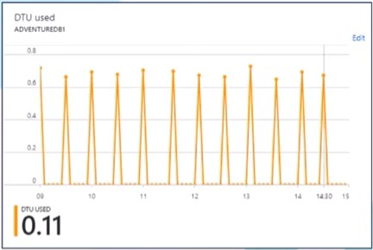
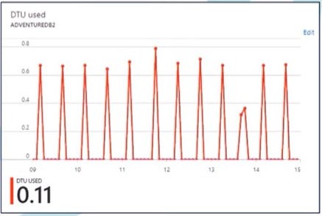
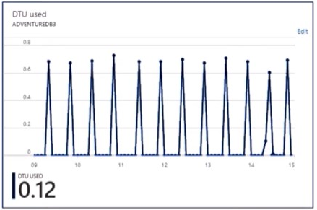
Three Singleton Databases
Singleton databases with unpredictable and intermittent usage patterns can be consolidated into a single server using elastic pools for better optimization.
Database 1
Database 2
Database 3

Slide 17
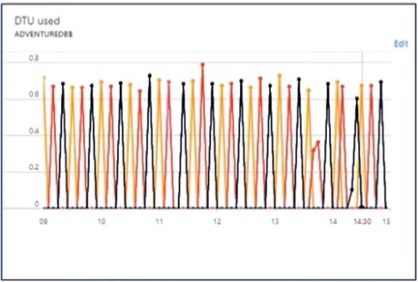
Elastic Pools
Resources combined into a single elastic pool.

Slide 18
Thank you!

